Slide 1
Affordance and Emotions
ICT312 Karl Tysoe, Liu Yi, Michael Keirnan, Ray Forster

Slide 2
Affordances
“Affordances are the inherent uses that an object in the environment furnishes to their user, for good or ill. An object is said to afford a function to potential users. An object’s complete set of affordances defines its possible functions. Affordances are therefore a form of communication between objects and their users.” - (Gibson, 1979).

Slide 3
Affordance Data Structures
Data structures should be fairly simple
Struct Affordance – affordanceTag, float value, entity*
When querying the Affordance System, a vector of nearby Affordances are returned.

Slide 4
Emotions
Personality
Traits
Emotions – Negative
Emotions - Positive
Moods

Slide 5
Effects of Emotions
The Emotional state of an entity can change the way they interact with objects
If an entity is happy and sees a flower they might pick it, if they are angry they might kick it.

Slide 6
Emotion Data Structures
HumanValues is a struct of structs
Physical struct
Vital struct
Mental struct
Used inside Personality class. There are 2 HV per personality: Thresholds and Dynamics.

Slide 7


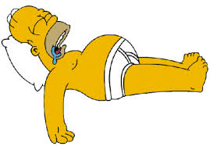
Emotion Data Structures (cont)
Vital Struct:
These values are mostly needs.
Hunger, thirst, sleep, bladder, (toxication).
Values constantly rise (except toxication)
Are lowered by intaking a value (eat) etc
Toxication is raised by drinking!

Slide 8
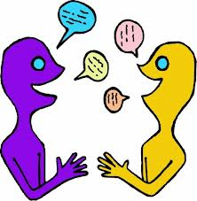

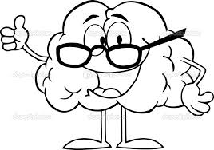
Emotion Data Structures (cont)
Mental Struct:
Mental is a combination of needs and states
Talk, curiosity, boredom, fear, emotion, memory
Talk (need) rises all the time.
Boredom rises with lack of doing things (from brain)
Fear comes from external interaction
Emotion is calculated by the amount of needs being met.(8 needs, total 80 points) emotion threshold determines midpoint. Each side is divvied to 4, with an emotional state that matches.

Slide 9
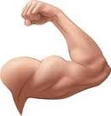

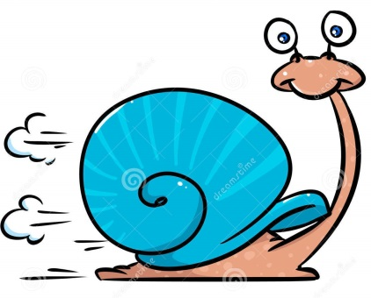
Emotion Data Structures (cont)
Physical Struct :
These values are all calculated by using a combination of vital and mental dynamics.
Strength, agility, stomach, sight, health
Strength = str thresh – (hunger * thirst /100)
Agility = agi thresh – (hunger*sleep/100)
etc

Slide 10
NPC Techniques
Traits
Changes the way an NPC reacts to the world
Modifiers on the threshold values
Quirks
Minor traits?
Major, minor NPCs
Dialog (optional)

Slide 11
Brain Class
Affordance – Query the world
Personality – Emotions, Traits, needs
Navigation
FSM
Dialog (optional)

Slide 12
Navigation
FSM
WORLD
Brain
Affordance Singleton
Personality
Dialog

Slide 13
References
http://www.gurusoftware.com/GuruNet/Personal/Levels.htm#Planes - Our Human Makeup; Roy Posner

